Slide 1
ABC 123 An educational app for children
BCCS12 - Amrish, Arman, Pou, Sarah, Yousuf

Slide 2
Who is our target demographic?
The target demographic of our educational app for children was mainly children in nursery and reception aged 3 – 5 who are learning basic words and numbers for the first time. Our secondary target market was parents of these children and they would primarily be in the age groups of 25 – 44.
We wanted to capitalise on the growing market for children’s educational apps. As part of our research it became clear that mobile application use was increasing amongst children under 8 and there was niche that we could fill for early years learning.

Slide 3
How can users use our app?
Our app can be navigated by the user using tap interactions with the onscreen elements. In the current build (pending further user testing) we have avoided using swipe gestures as this can initially be unintuitive for young children.
There are two main sections to app, one is for learning words and letters and other is for learning numbers.
Each of the sections is further broken down into a ‘learning’ part and a ‘quiz’ part. The learning parts aim at introducing the content whilst the quiz is for more advanced users to test their knowledge.

Slide 4
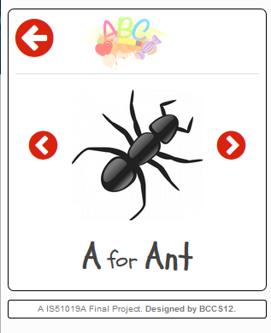


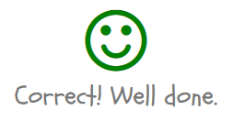
Design Concepts
Given the limited familiarity with technology of our target market we tried to ensure that design of our app was simple and user friendly. Some of the design decisions we took included use of the following:
Clipart-style images and handwritten fonts – This style was chosen as it is consistent with the art style found in children’s books
Skeuomorphic design ideas (e.g. home icon, smiley faces) – This was chosen as it can help relate real-world understanding to digital interfaces
Large icon and font sizes – As young children’s motor control isn’t fully developed this can minimise the number of user errors
Written instructions on how to use the app – This was primarily for the benefit of the parent so they can coach their child during initial play sessions

Slide 5
Evaluation and User Testing
There were two primary strands to our user testing, internal testing and user testing:
Internal testing – The primary focus of our internal testing was to ensure that the technical aspects of the app were working. We extensively tested each feature to ensure that the app behaved as expected and that identified bugs were eliminated. Throughout the design process we also referenced the ‘personas’ that we created to ensure that the overall direction of the app met the criteria that we set.
User testing – We tested partially complete builds of the app with members of our target audience, i.e. both young children and parents. We noted down the results of the feedback including what they did and didn’t like about the overall design and used it to enhance the areas that were working and fix what was not.

Slide 6
Live Demonstration http://doc.gold.ac.uk/~aparm001/introdm/cw2/index.html

